Slide 1
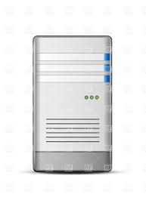
Server#1
Server#2
Direct connection with servers NIC-3, unique IP address
connection with servers using NIC-1 & NIC-2 and unique IP address for each NIC.
Switch
Switch
Suggest if we can configure
1.1.1.11 server1 server1-1
1.1.2.11 server1-2
1.1.3.11 server1-3
1.1.1.12 server2 server2-1
1.1.2.12 server2-2
1.1.3.12 server2-3 in host file and
data = "server1-1,server1-2,server1-3$server2-1,server2-2,server2-3“ and similar for event.

