Slide 1
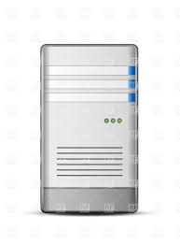
Server#1
Server#2
Direct connection with servers NIC-1, unique IP address (server1-1 & server2-1)
connection with servers using NIC-2 (server1-2 & server2-2)
Switch
Switch
NIC-3 with unique IP will be connect to device, so device network will be formed using NIC-2 & NIC-3. And NIC-2 will shared between WinCC OA and Device network.

