Slide 1
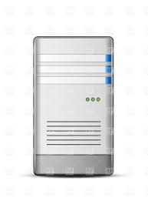
PSS
SSS
WinCC OA 3.11 Solaris SPARC
DB#1
Replica of DB#1
DB#2
Oracle database
Oracle database
Oracle database

